Slide 1
The Ring Amplifier: Scalable Amplification with Ring Oscillators
Benjamin Hershberg¹, Un-Ku Moon²
¹ imec Leuven, Belgium
² Oregon State University Corvallis, USA

Slide 2
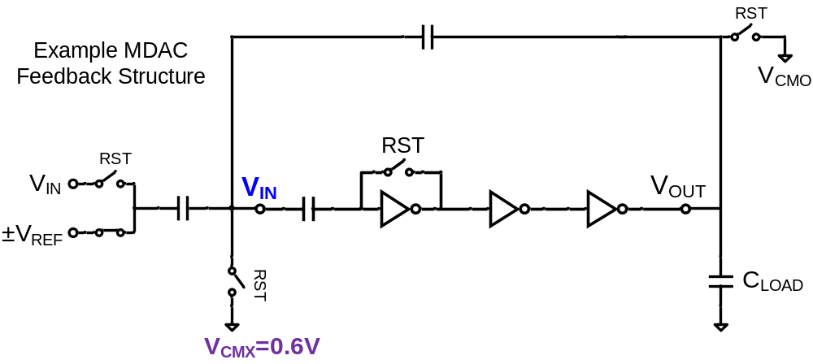
Ring Oscillator in Switched Capacitor Feedback

Slide 3
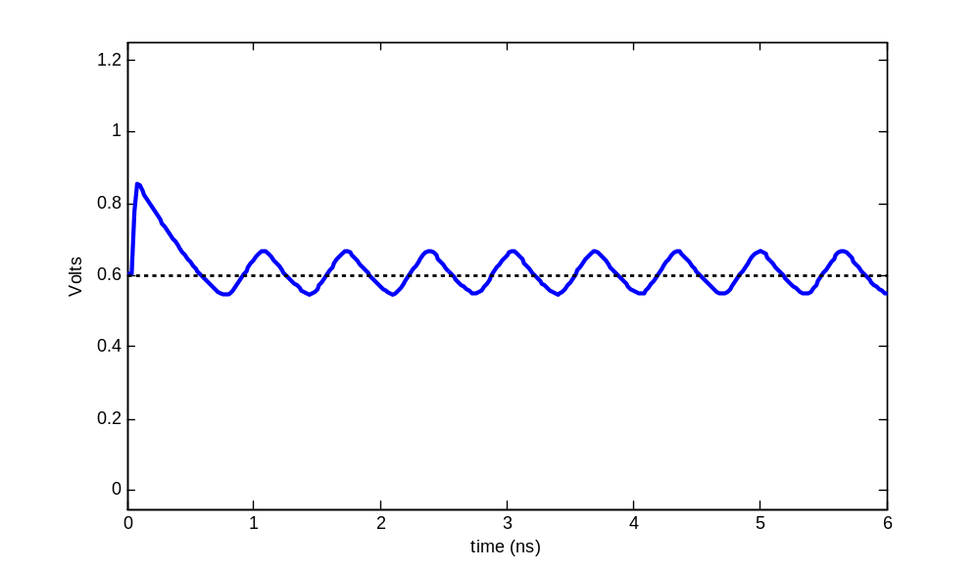
Ring Oscillator Sample Waveform
1.2
1
0.8
0.6
0.4
0.2
0
V_{IN}
V_{CMX} = 0.6V
(ideal settled input value)
Volts
0 1 2 3 4 5 6
time (ns)

Slide 4
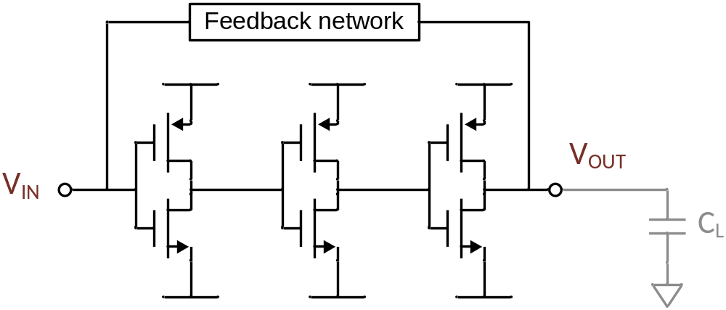
Ring Oscillator: The Perfect Switch-Cap Amplifier?
High frequency poles, large bandwidth
Rail to rail swing
Maximal slewing efficiency
Small, simple layout
High cascaded gain
Inherent class-AB behavior
Fully compatible with digital CMOS

Slide 5
Ring Oscillator: The Perfect Switch-Cap Amplifier?
IT’S AN OSCILLATOR!
Sounds great! Only one problem…

Slide 6
Oscillator / Amplifier duality
Any unstable ring oscillator can become a stable amplifier
Slide 5
Slide 5

Slide 7
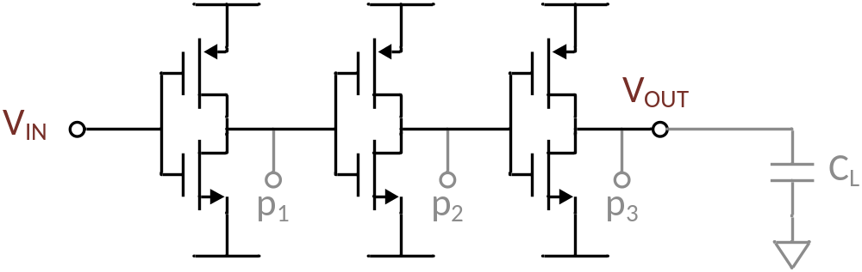
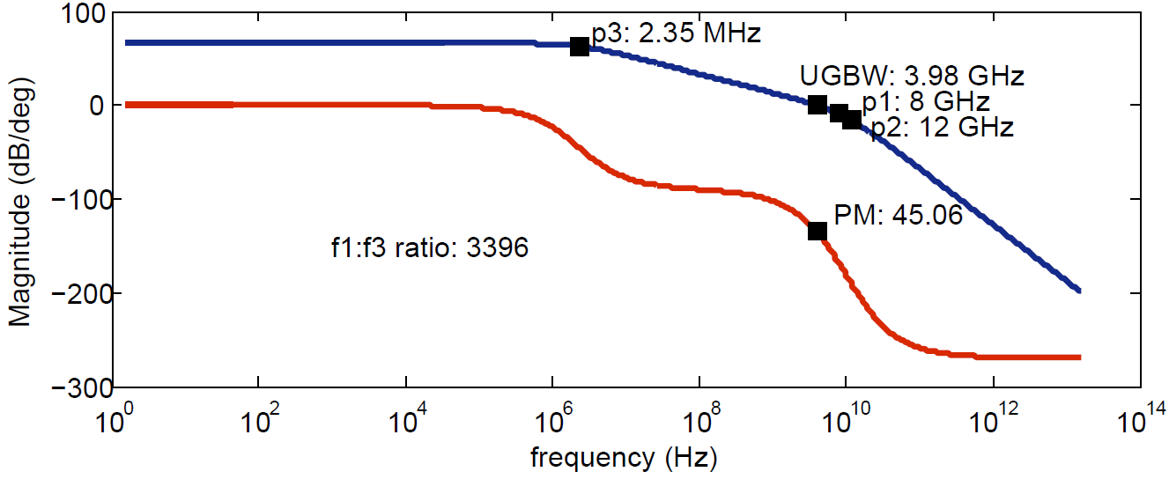
Small-signal three stage amplifier
Optimal configuration: dominant pole p₃

Slide 8
Ring Amplifier
Time-Domain?
Large signal?
Optimal small-signal steady-state behavior:
Multiple cascaded gain stages
Stabilized by dominant output pole

Slide 9
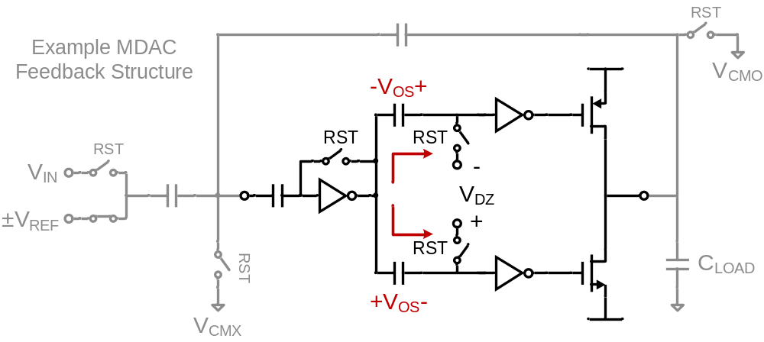
Ring Amplifier: Basic Theory
Split signal into two separate paths
Embed offset in each path

Slide 10
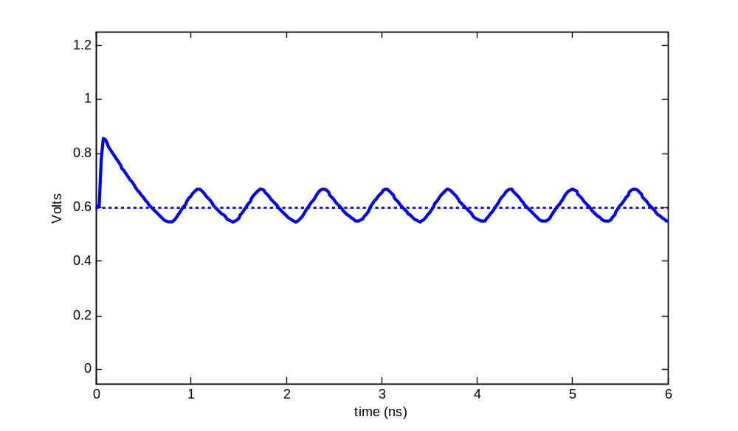
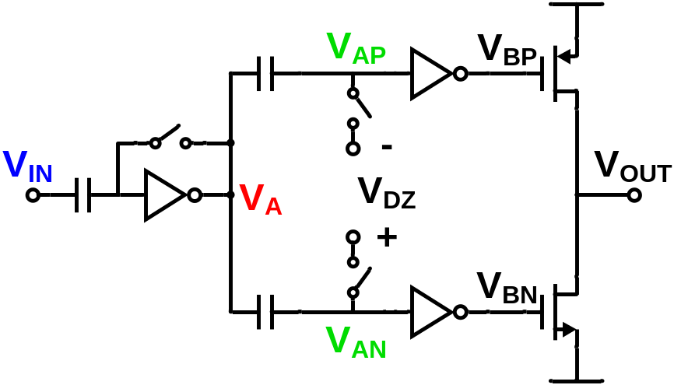
Ring Amplifier Sample Waveform
V_{DEADZONE} = 0mV
1.2
1
0.8
0.6
0.4
0.2
0
Volts
0 1 2 3 4 5 6
time (ns)

Slide 11
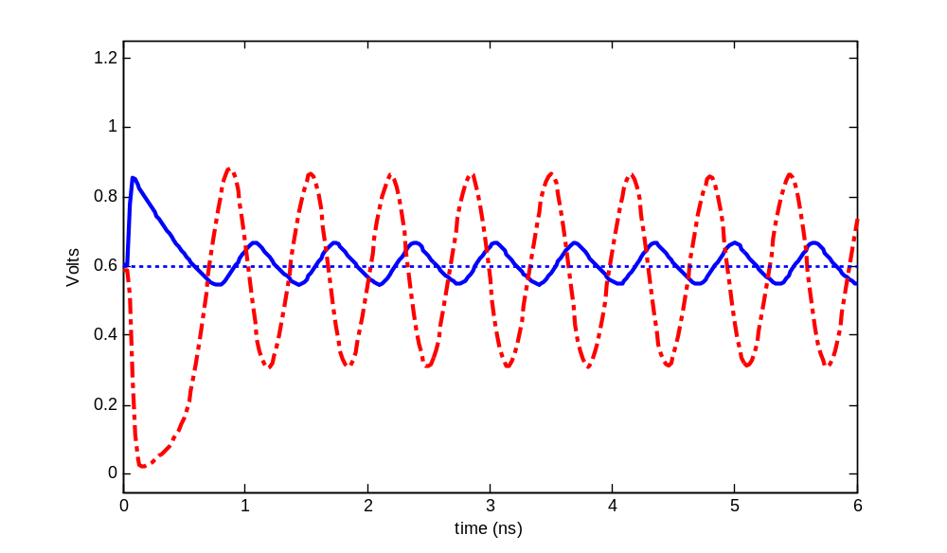
Ring Amplifier Sample Waveform
V_{DEADZONE} = 0mV
1.2
1
0.8
0.6
0.4
0.2
0
Volts
0 1 2 3 4 5 6
time (ns)

Slide 12
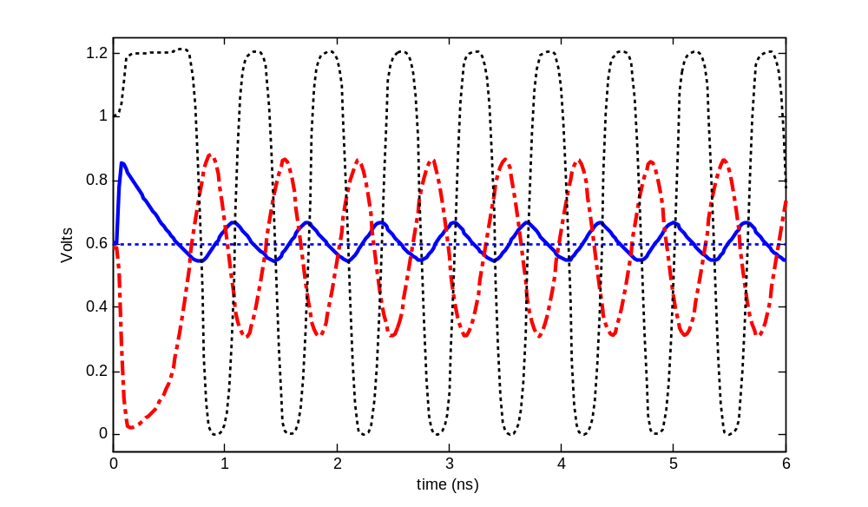
Ring Amplifier Sample Waveform
V_{DEADZONE} = 0mV
1.2
1
0.8
0.6
0.4
0.2
0
Volts
0 1 2 3 4 5 6
time (ns)

Slide 13
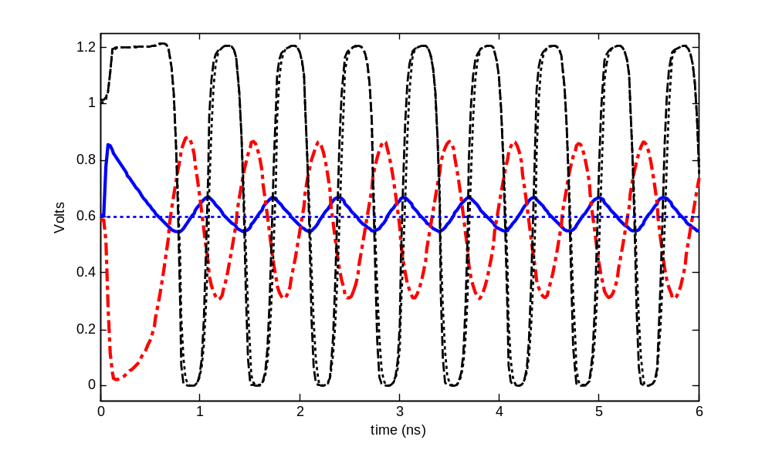
Ring Amplifier Sample Waveform
V_{DEADZONE} = 0mV
1.2
1
0.8
0.6
0.4
0.2
0
Volts
0 1 2 3 4 5 6
time (ns)

Slide 14
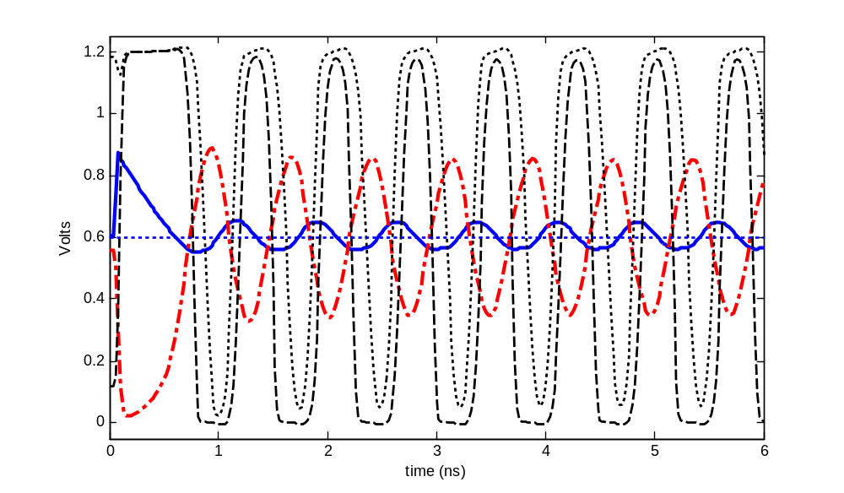
Ring Amplifier Sample Waveform
V_{DEADZONE} = 200mV
1.2
1
0.8
0.6
0.4
0.2
0
Volts
0 1 2 3 4 5 6
time (ns)

Slide 15
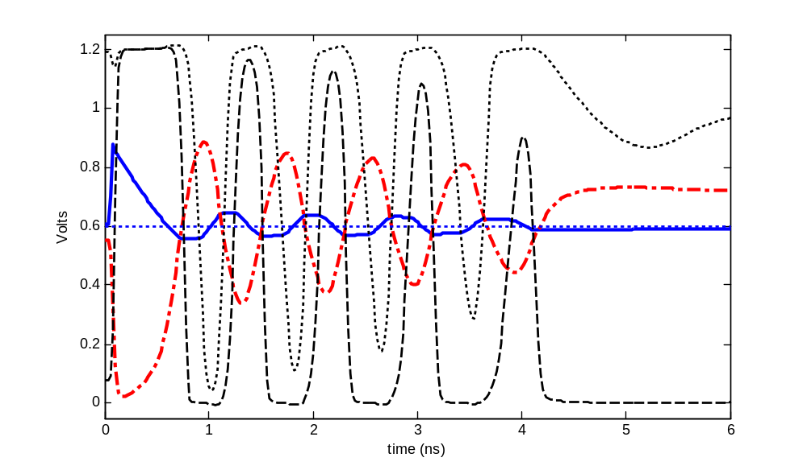
Ring Amplifier Sample Waveform
V_{DEADZONE} = 250mV
1.2
1
0.8
0.6
0.4
0.2
0
Volts
0 1 2 3 4 5 6
time (ns)

Slide 16
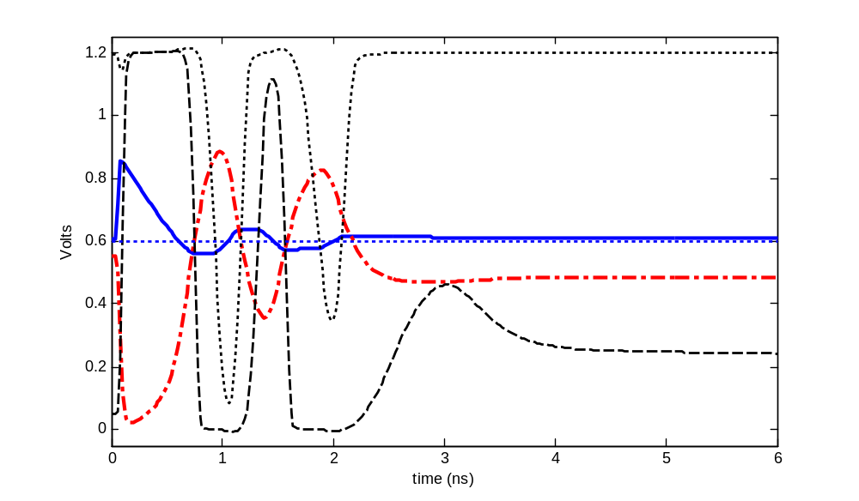
Ring Amplifier Sample Waveform
V_{DEADZONE} = 300mV
1.2
1
0.8
0.6
0.4
0.2
0
Volts
0 1 2 3 4 5 6
time (ns)

Slide 17
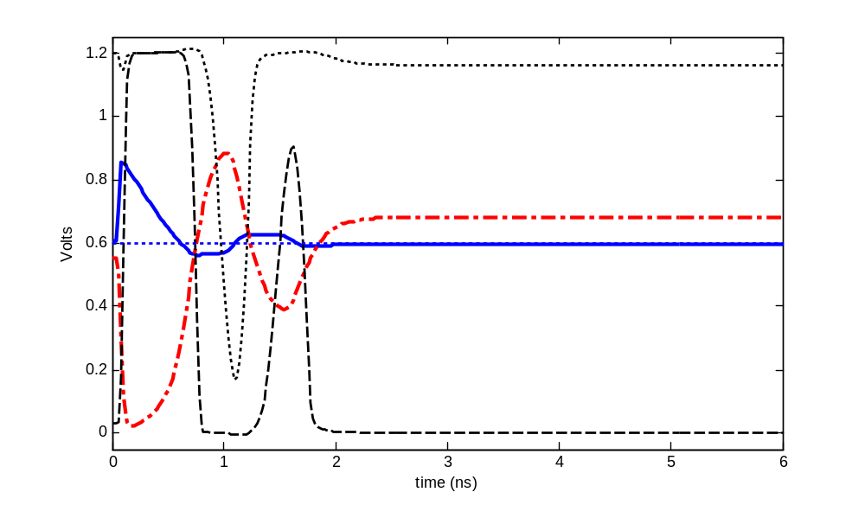
Ring Amplifier Sample Waveform
V_{DEADZONE} = 350mV
1.2
1
0.8
0.6
0.4
0.2
0
Volts
0 1 2 3 4 5 6
time (ns)

Slide 18
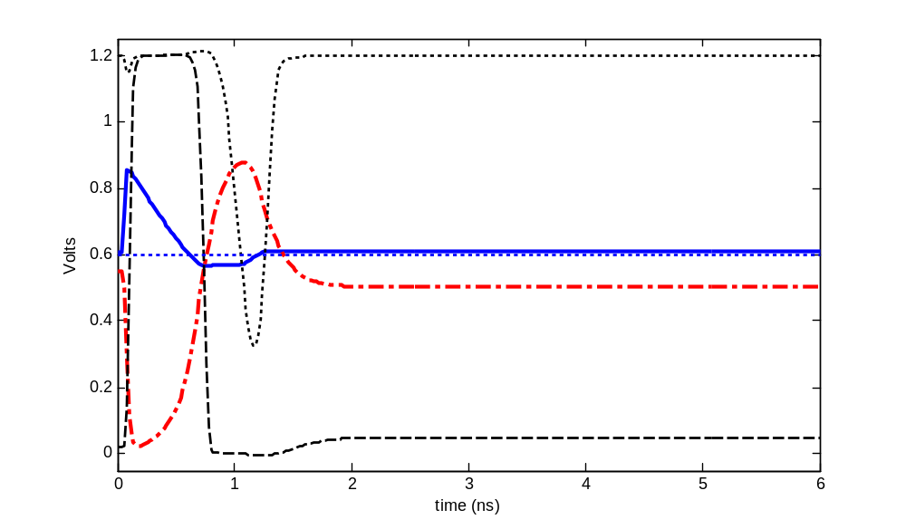
Ring Amplifier Sample Waveform
V_{DEADZONE} = 400mV
1.2
1
0.8
0.6
0.4
0.2
0
Volts
0 1 2 3 4 5 6
time (ns)

Slide 19
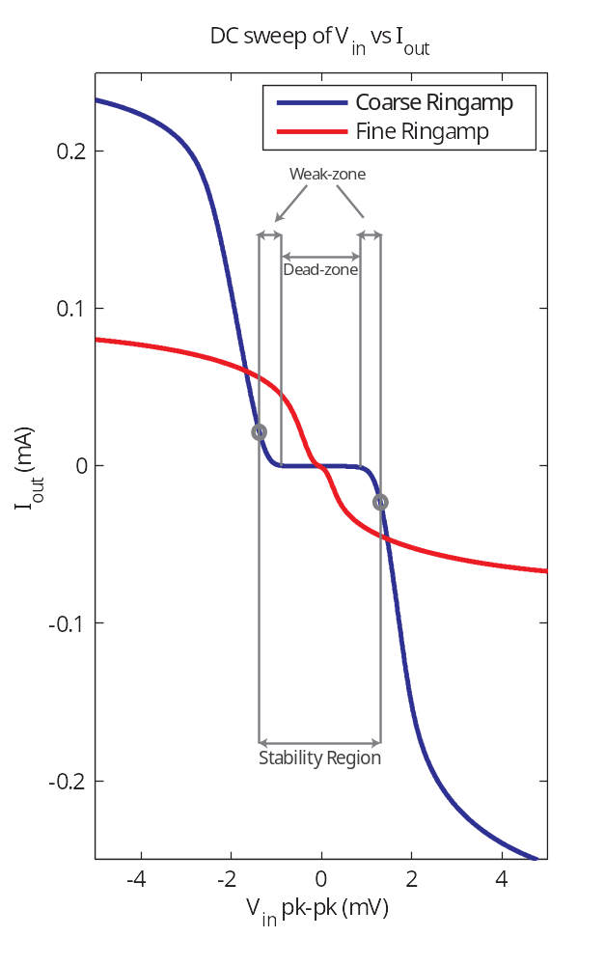
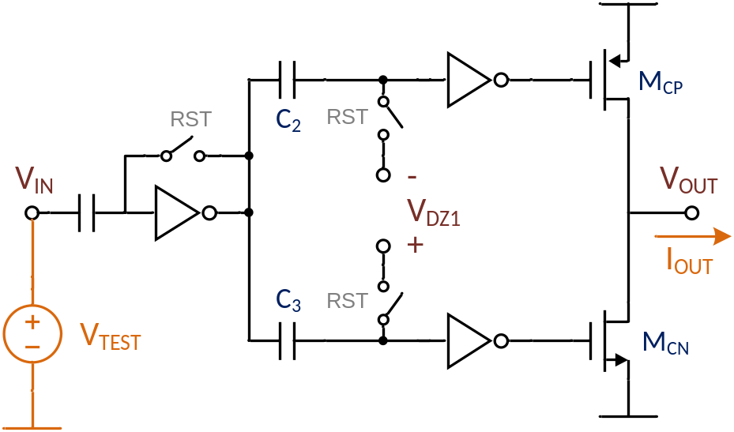
What is the “Stability Region”?
V_{DZ1} large
  Dead-zone: Class-B
  Distortion limits accuracy
V_{DZ1} small
  Weak-zone: Class-AB
  Only finite gain limits accuracy
  Gain and output swing advantage
[Hershberg, VLSI 2013]

Slide 20
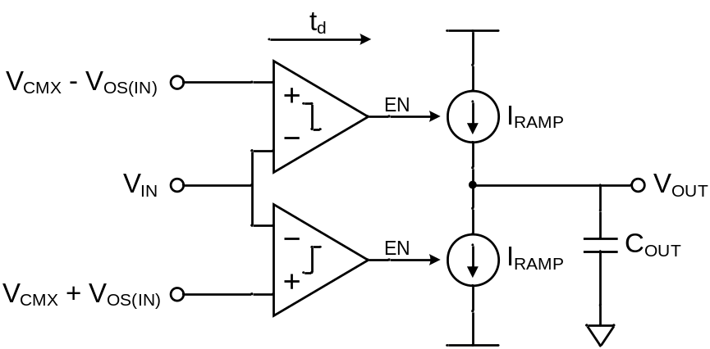
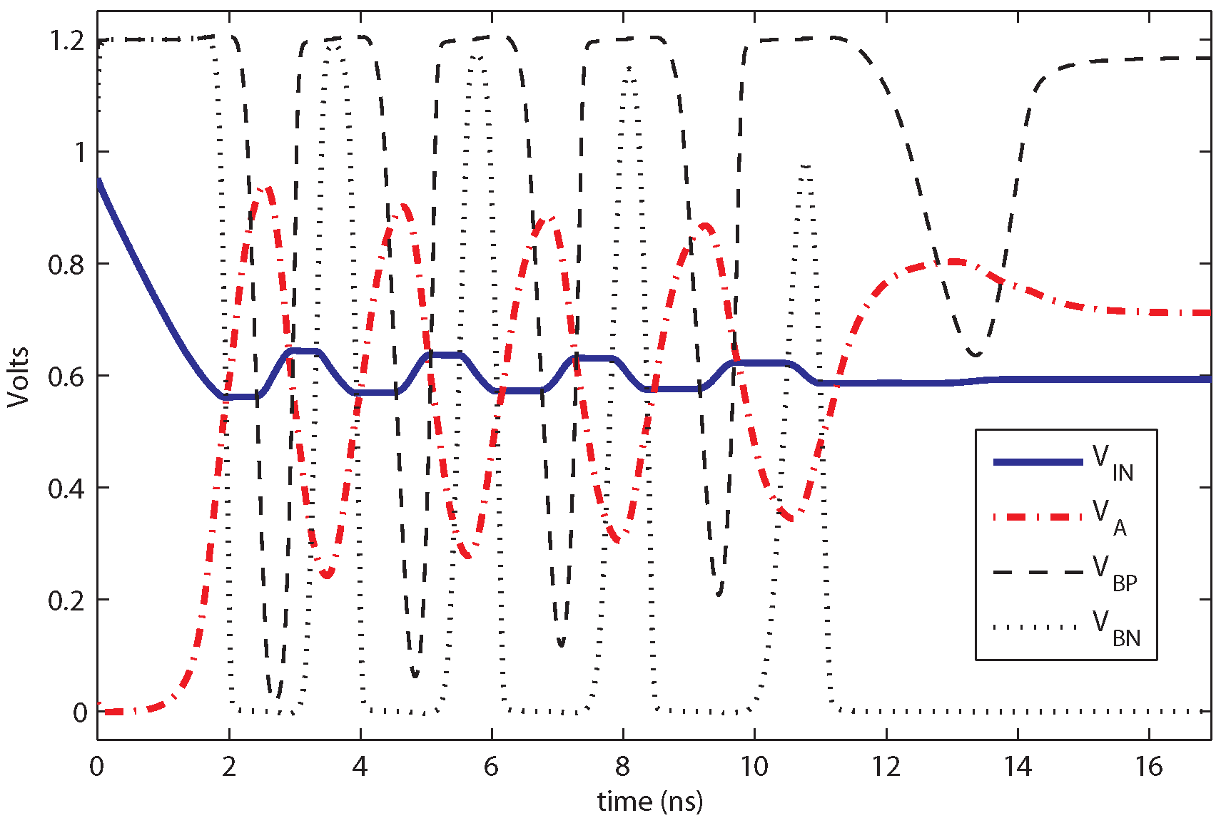

Initial Slewing
A boundary case: operating almost unstable
Bi-directional comparator and
current source
  Zero-Crossing Based Circuit
Rail-to-rail current source biasing

Slide 21
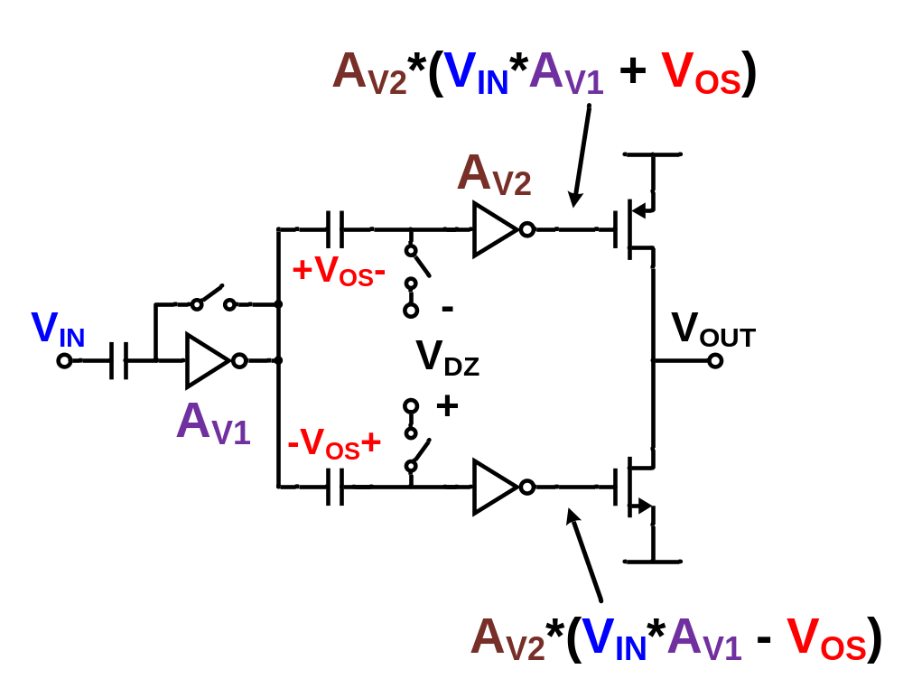
Stabilization

Slide 22
Stabilization
+V_{OS}-
V_{DD}/2
V_{DD}/2 - V_{OS}
V_{DD}/2 + V_{OS}
V_{DD}/2
-V_{OS}+
Separate signal paths: gain-limited output swing for large input swing.

Slide 23
Stabilization
A boundary case: operating almost unstable
Reduced avg. overdrive voltage
Reduced output slew rate
Reduced oscillation amplitude
Gain-limited internal swings

Slide 24
Stabilization
A boundary case: operating almost unstable
V_{A}
V_{IN}
A more subtle secondary effect…
Slew limited gain
During stabilization
  Small V_{A}/V_{IN}
During steady-state
  Large V_{A}/V_{IN}
Enhances accuracy/speed tradeoff

Slide 25
Stabilization
1) Offset embedding creates a large signal finite gain effect
2) Large signal finite-gain effect strengthens with non-linear time feedback
3) Dynamically shifts small signal pole, granting stability and gain

Slide 26
Ring Amplifier Core Benefits
Exponential dynamic stabilization
Very fast
Well defined tradeoffs

Slide 27
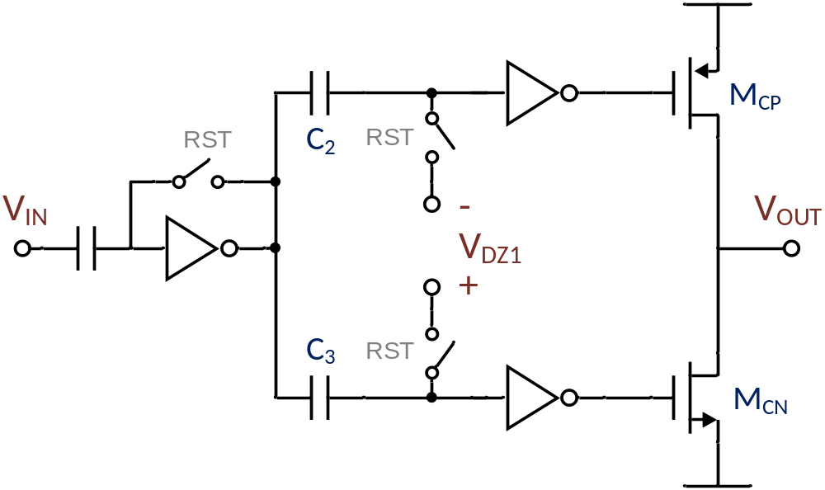
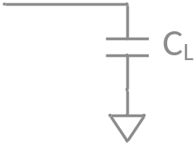
Ring Amplifier Core Benefits
Slew-based charging
Charges with maximally biased, digitally-switched current sources
  V_{GS} = V_{DD}
  Can be very small, even for large C_{LOAD}
  Decouples internal speed vs. output load requirements
Rail-to-rail inverters
Max V_{OV}
+
-
Very small transistors
+
-
Max V_{OV}

Slide 28
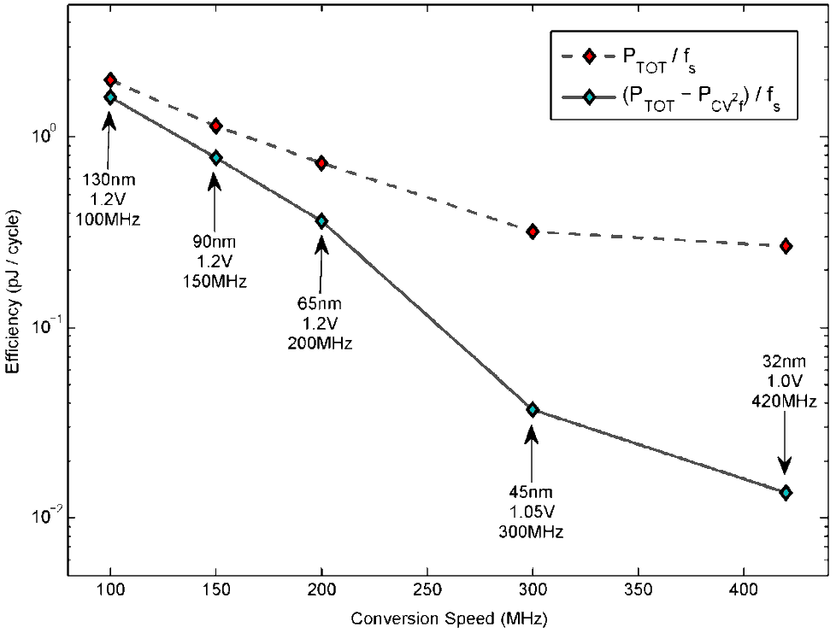
Ring Amplifier Core Benefits
Scalability (Speed/Power)
Internal speed/power (mostly) independent of C_{LOAD}
  Inverter t_{d}, crowbar current, parasitic C’s
  Digital power-delay product scaling benefits apply
Power/speed product scales with digital process trends

Slide 29
Ring Amplifier Core Benefits
Scalability (Output Swing / SNR)
Compression immune: rail-to-rail output swing
  V_{OV} pinchoff: decreases V_{DSAT}, decreses I_{D}, increases r_{o}
small V_{OV} = V_{GS}-V_{T}
-
+
+
Large r_{o},
small V_{DSAT}
-
Low frequency output pole
Dynamic biasing = wide, compression free output swing
-
+
Large r_{o},
small V_{DSAT}
-
+
small V_{OV} = V_{GS}-V_{T}
Notes:
Only limited by practical RC-settling constraints

Slide 30
Ringamp Implementations
Slide 29
Slide 29

Slide 31
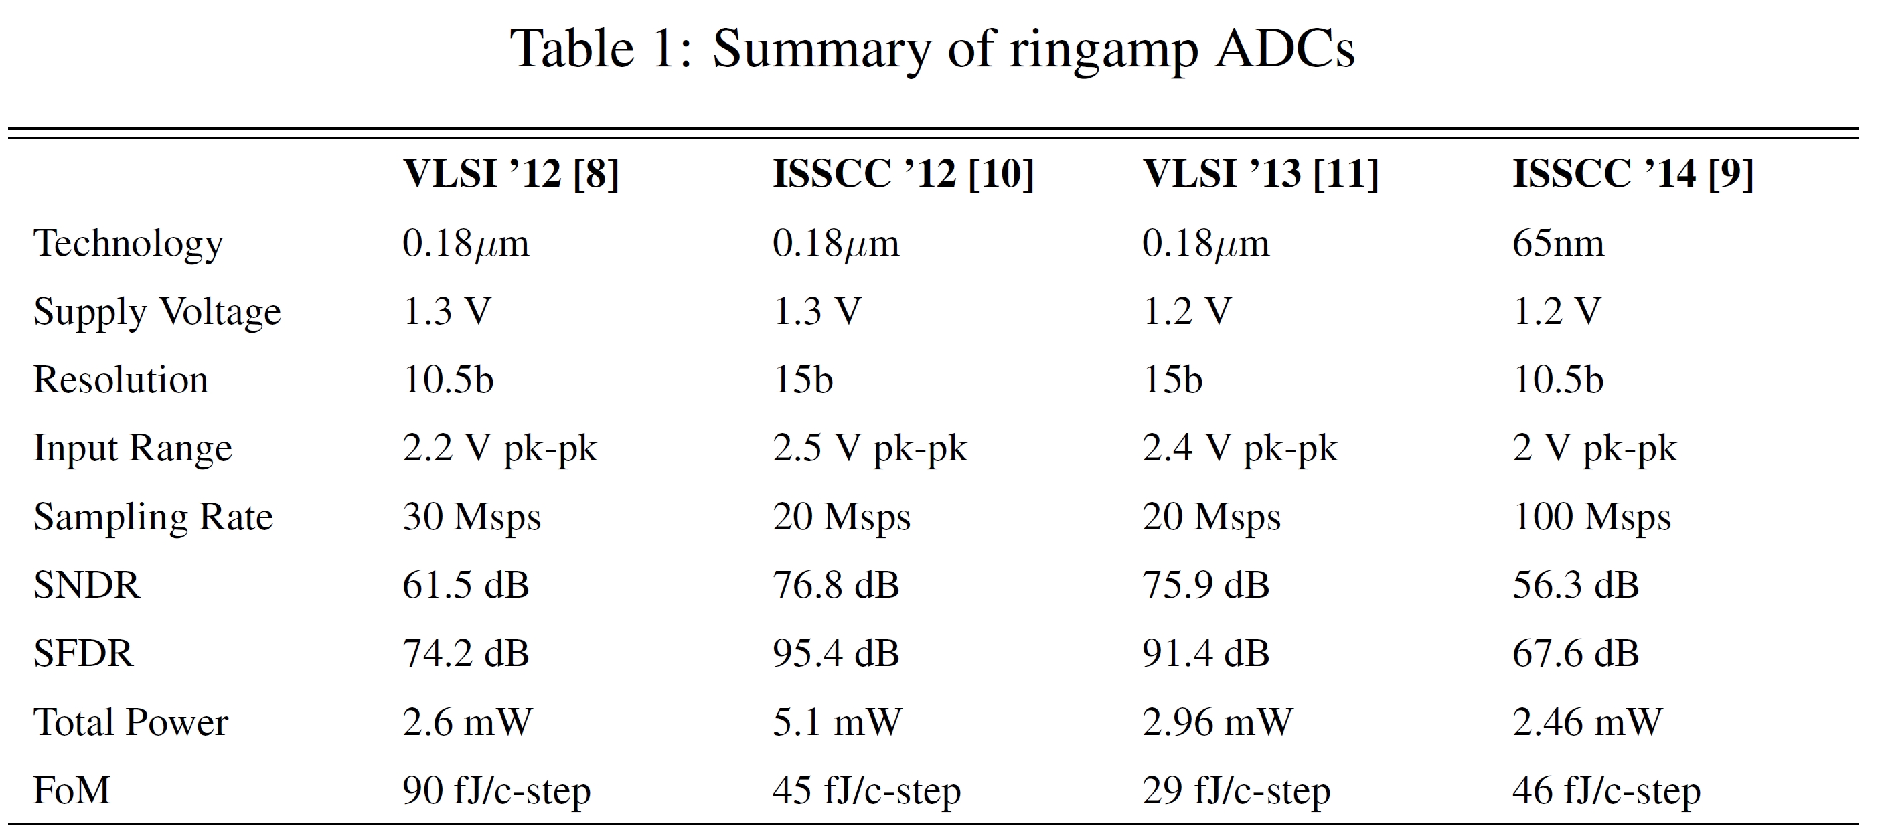
Survey of Ringamp Structures
Basic Proof
of Concept
High-resolution
High-resolution (ringamp only)
Nanoscale CMOS improvements

Slide 32
Coarse Ringamp
10.5b Pipelined ADC
Hershberg, VLSI 2012
[Hershberg, VLSI 2012]
Slide 31
Slide 31

Slide 33
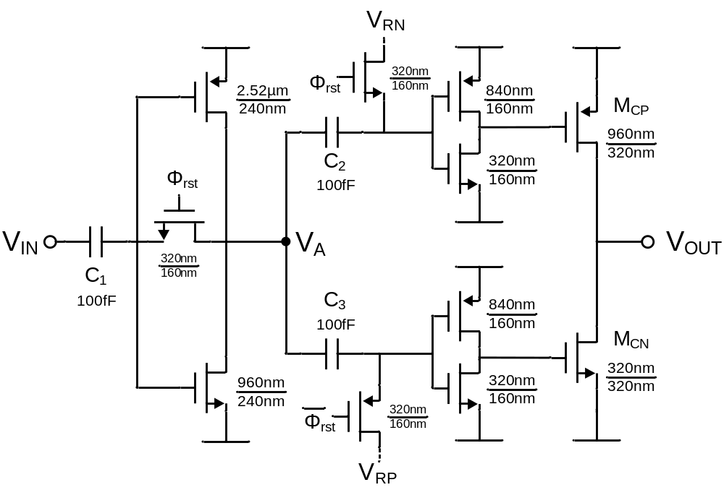
Coarse Ringamp Prototype
Basic ringamp prototype
  Minimum size transistors
  Rail-to-rail output swing
  Good noise performance
[Hershberg, VLSI 2012]

Slide 34
Split-CLS
15b Pipelined ADC
Hershberg, ISSCC 2012
[Hershberg, ISSCC 2012]
Slide 33
Slide 33

Slide 35
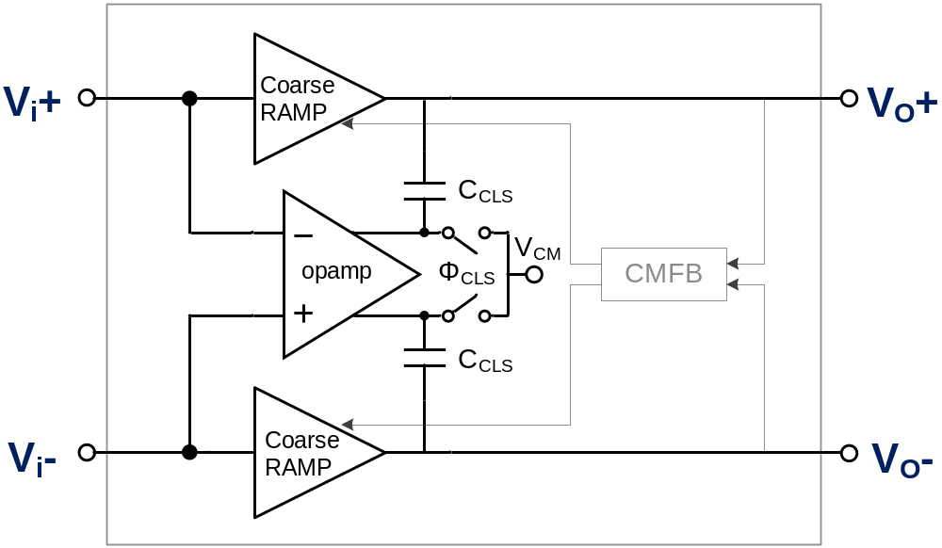
Split-CLS (Correlated Level Shifting)
Split-CLS: Gain Enhancement Technique
[Hershberg, ISSCC 2012]

Slide 36
Composite Ring Amplifier Block
15b Pipelined ADC
[Hershberg, VLSI 2013]
Slide 35
Slide 35

Slide 37
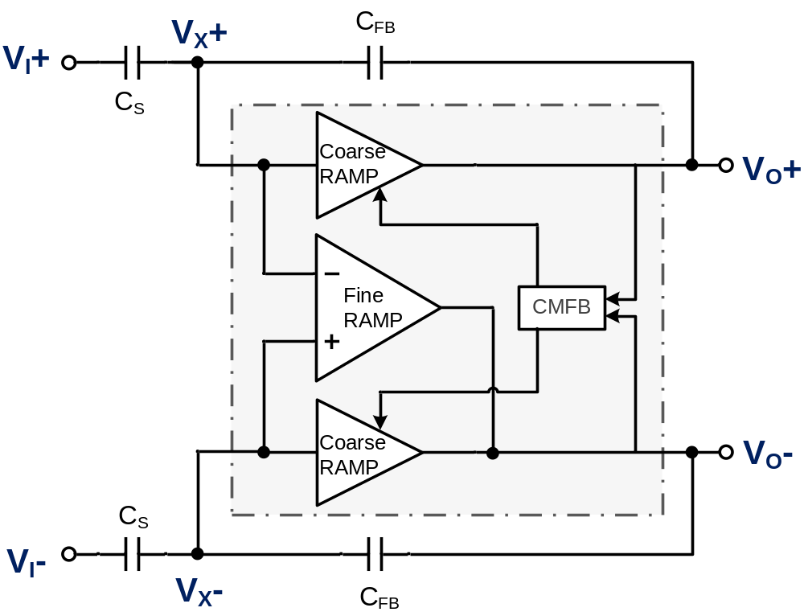
Composite Ring Amplifier Block
Composite Ring Amplifier Block
Coarse
  2 Class-B ringamps
Fine
  1 Class-AB ringamp
[Hershberg, VLSI 2013]

Slide 38
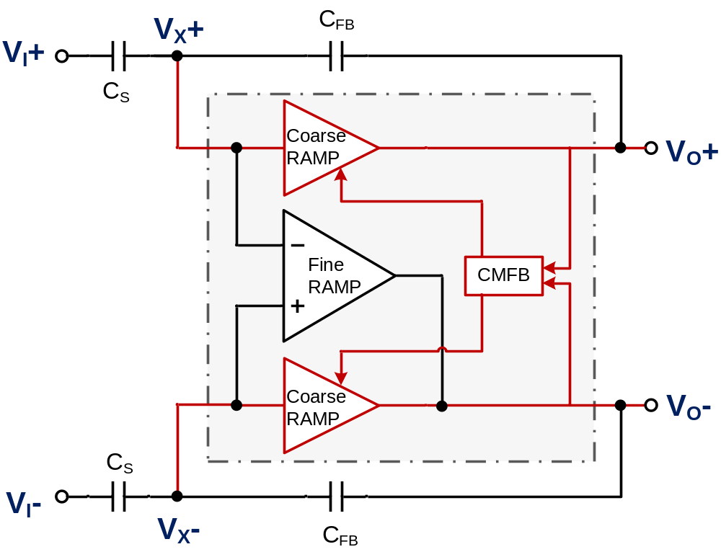
Composite Ring Amplifier Block
Fast coarse charge
  All 3 ringamps contribute
Coarse ringamps dominate and set:
  Pseudo-Differential
  Common-Mode
Auto-disconnect
  No conduction to output once inside dead-zone
[Hershberg, VLSI 2013]

Slide 39
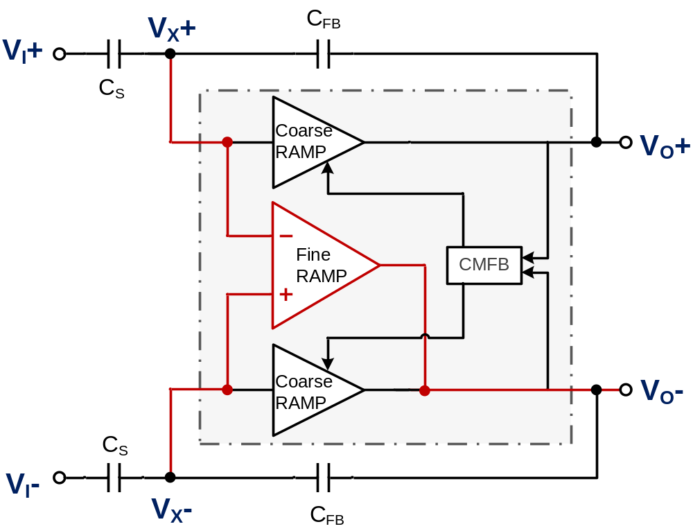
Composite Ring Amplifier Block
Fine settle
  V_{O}+ floating
  V_{O}- connected
  Common-mode ok
Detect differentially, charge single-ended
  V_{O}- settles around a floating V_{O}+
[Hershberg, VLSI 2013]

Slide 40
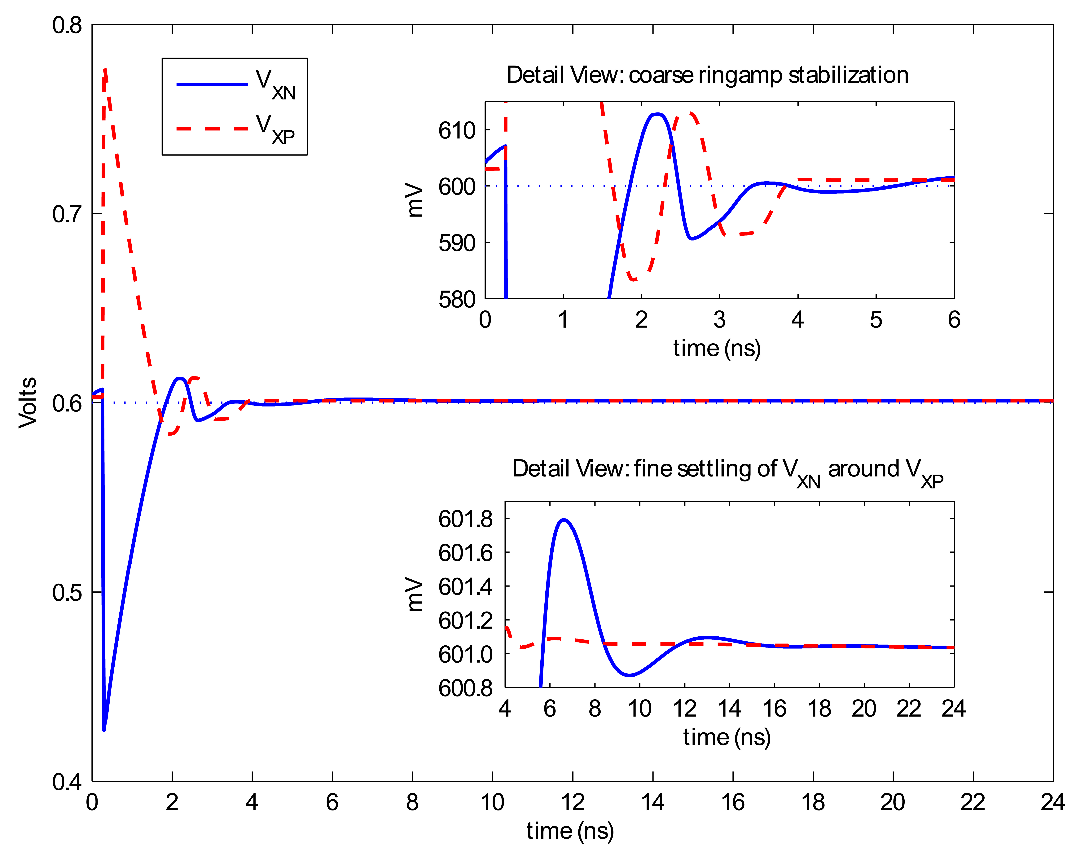
Composite Ring Amplifier Block
Coarse ringamp dead-zone
[Hershberg, VLSI 2013]

Slide 41
Composite Ring Amplifier Block
[Hershberg, VLSI 2013]

Slide 42
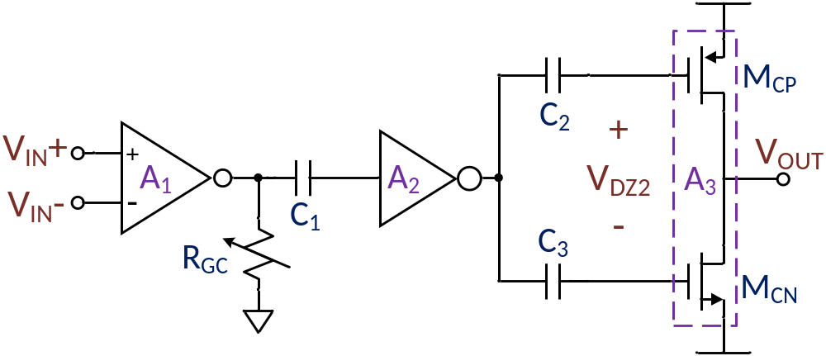
Class-AB Ringamp Structure
Offset embedded between stages 2 and 3
Guarantees weak-inversion
  Enhanced Gain
  Wide Output Swing
Reduced slewing efficiency…
[Hershberg, VLSI 2013]

Slide 43
Composite Ring Amplifier Block
High accuracy ADC using only ringamps
Maximum scalability
[Hershberg, VLSI 2013]

Slide 44
Self-Biased Ring Amplifier
10.5b Pipelined ADC
Lim, ISSCC 2014
[Lim, ISSCC 2014]
Slide 43
Slide 43

Slide 45
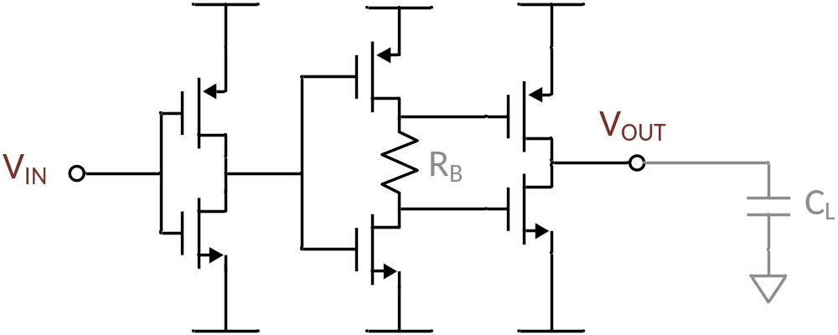
Setting Stability Region with a Resistor
+
V_{OS}
-
Dynamic pole adjustment using only R_{B}
Initial slew, V_{OS} = 0V
  Max overdrive, max efficiency
V_{OS} dynamically grows during stabilization
[Lim, ISSCC 2014]

Slide 46
Ring oscillators do make great amplifiers!
→ Slewing
→ Output Swing
→ Bandwidth
→ Gain
→ Scaling benefit
Small Signal
Large Signal
Transient

Slide 47
Where Next?
Anything clocked with a capacitive load …
Discrete Time Filters
DT Sigma-Delta
Etc.
Time to re-examine some old assumptions…

Slide 48
Thank you for your attention.

